Slide 1
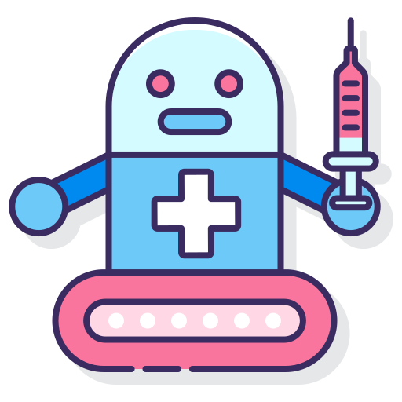
HealthCare ChatBot
Name : Raunak Kumar
Reg No. : 12007198
Dept. : School of Computer Science and Engineering

Slide 2
AI-Driven Healthcare Assistance for Immediate Medical Support and Doctor Recommendations
In the healthcare domain, there is a pressing need for an advanced AI-driven system that can provide immediate assistance and accurate recommendations to users seeking medical help. This system aims to address the challenges faced by individuals who require urgent medical advice, such as suggestions for immediate medication or guidance on which doctor to visit for specific health concerns.

Slide 3
Key objectives of the AI-driven healthcare assistance system
Real-Time Support
Personalized Medication Suggestions
Doctor Recommendations
User-Friendly Interface

Slide 4
ChatBot Demonstration

